Slide 1
Forging students into entrepreneurs to solve real-world clinical problems
ideas.wustl.edu

Slide 2
WHAT IS IDEA LABS?
Creating Student Led Ventures
Founded in 2013
Currently an independent non-profit committed to fostering life science entrepreneurship in St Louis
IDEA Labs is the first student operated bio-tech incubator in the country
We form student teams focused on clinical problems and provide the resources needed to develop solutions
Promising teams go on to form ventures and commercialize their inventions

Slide 3
Unique & Innovative Approach
Connect student founders & clinical mentors
Generating Businesses
Develop & recruit talent
Identify needs
Market & patent analysis
Prototyping
Business plan & pitch development
University & Hospital Integration
Unrestricted access to university resources
University waives all rights to intellectual property
Clinical trial support
Physician and patient access
Clinical problem database (>150 needs)
Office space
VC pitching/awards
Pro bono legal services – LLC & patent filing
Resources
Prototyping - 3D printers, machining, software
Business & market advisors
St. Louis manufacturing
Resource sharing with other local incubators

Slide 4
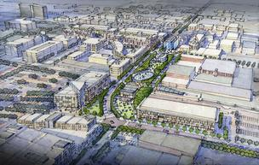
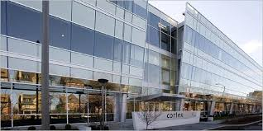
CREATING A MIDWEST INNOVATION CLUSTER
St. Louis’ Potential
IDEA Labs: The bridge from academia to bioentrepreneurship
Community Commitment
CORTEX Entrepreneurship district - ($186 million biotech Investment)
Venture Capital:
Capital Innovators
Cultivation Capital
Arch Angels
Venture Services:
Biogenerator
iTEN
GatewayVMS
Kauffman Foundation
T-Rex
Cambridge Innovation Center
Business Plan Competitions: Olin & Arch Grants
Premier Medical Hub:
Washington University
Barnes Jewish Hospital
Ranked top 10 in the nation
Manufacturing Hub
MakeSTL
90 Industrial manufacturers within 30 miles
Industrial Hub
Sigma Aldrich (Biotechnology)
Monsanto
Boeing (McDonnell Douglas)
TUMS
CORTEX Biotech District
We’re helping to build an innovation cluster in St Louis

Slide 5
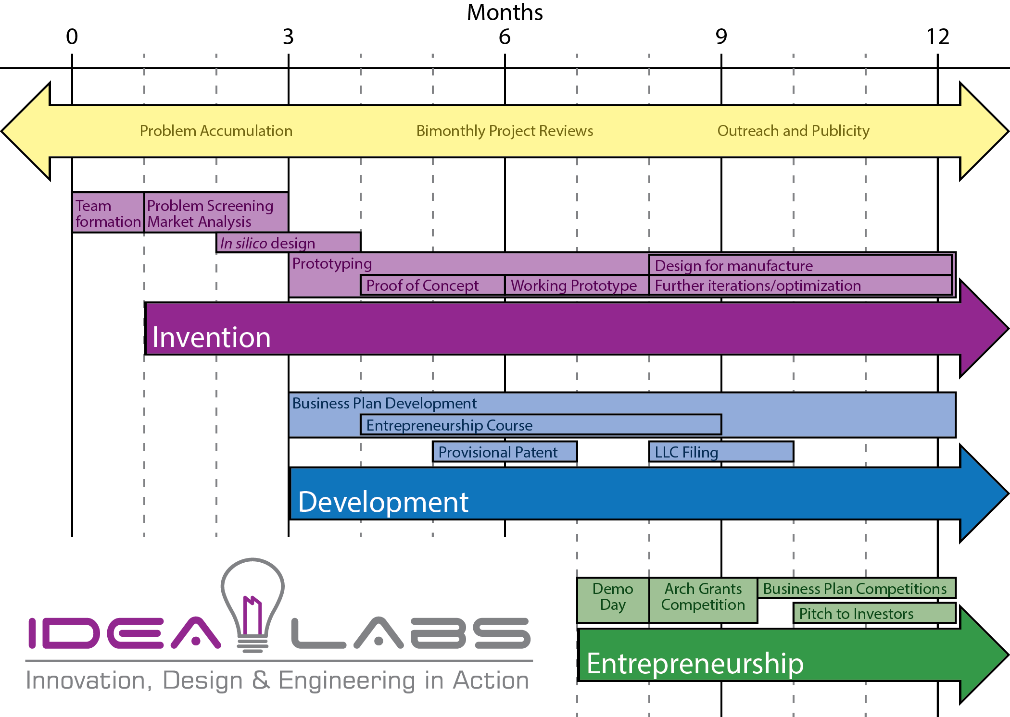
BRIDGING PROBLEMS WITH SOLUTIONS
Our Model
Invention Phase
Problem Bank Development:
Clinicians, residents, medical students identify & validate problems based on clinical need
Team Recruitment
Rigorous recruitment from engineering, medicine, business, and law (50% acceptance rate)
Criteria: Previous design and entrepreneurial experience, technical, and business skills
Organic formation around project managers
Research & Development
Rigorous market and patent analysis
Prototype and serial invention
Clinical trial support & testing
Manufacturing & Technical Advice
One-on-one pipeline into St. Louis Manufacturing
Monthly technical reviews

Slide 6
BRIDGING PROBLEMS WITH SOLUTIONS
Our Model
Development and Entrepreneurship Phase
Intellectual Property (IP)
Washington University waives all rights to any IP developed by IDEA Labs teams
IDEA Labs temporarily holds IP until LLC formation
Teams own all IP rights
Pro bono LLC & patent filing
Business Plan Development
Teams undergo intensive, guided business plan & pitch development
Capital Fundraising
Direct pitch route to angel and venture investors at Demo Day
Former advisors, and the community at large
Project Funding & Business Development Grants
Incremental funding is competitively awarded at confidential bimonthly project reviews

Slide 7
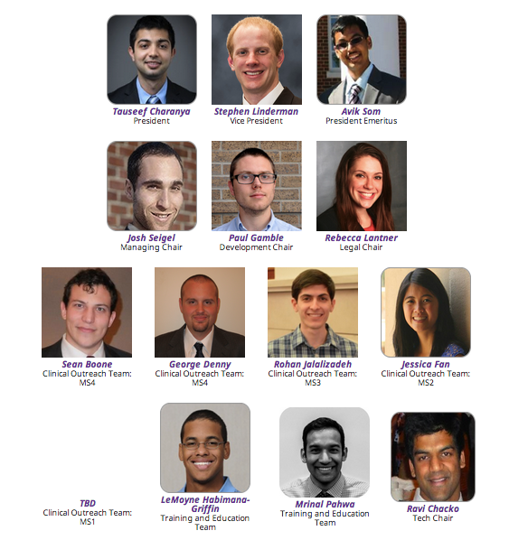
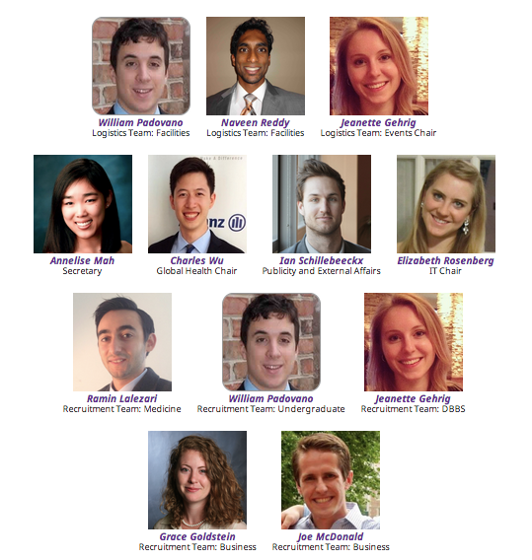
ORGANIZATIONAL LEADERSHIP: WHO WE ARE
Our Team

Slide 8
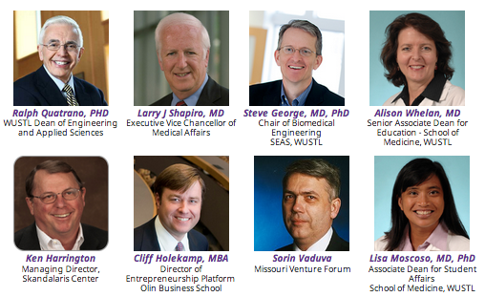
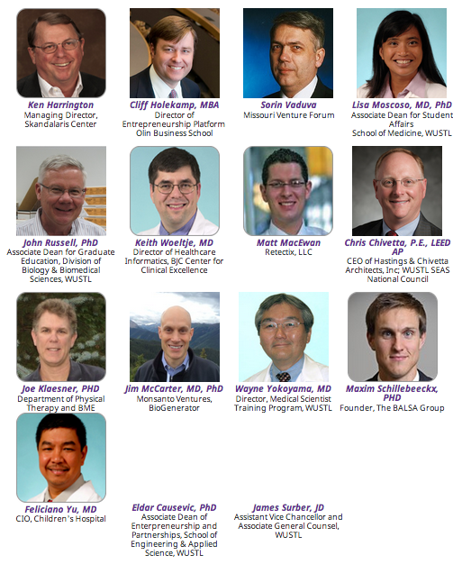
MENTORSHIP AND COMMERCIALIZATION ASSISTANCE
Selected Advisors & Partners

Slide 9
What to do with questions
Ask us

Slide 10
What to do with questions
Liaisons
Brett Gao | Avik Som
Michael Sevens | Ian Schillebeeckx
Bradley Settle | Ian Schillebeeckx
Maxwell Wang | Ravi Chacko
William Papper | Ramin Lalezari
Kevin Chen | Naveen Reddy
Wei Tao | Tauseef Charanya
Rob Coker | Paul Gamble
Manu Stephen | Mrinal Pahwa
Joseph Song | Annelise
Charlotte Guertler | Josh Siegel
Thomas Hong | George Denny
Michelle Mendiola | Jeanette Gherig
Sean Boone | (Sean)
Gregg Willcox | Steven Linderman
Erica Barnell | Will Padovano
EWH | Annelise Mah
joshsiegel1@gmail.com
240-506-3715

Slide 11
Here they are…
Teams (very tentative)
Team | Project Leader | Exec Liaison | 1 Undergrad | 1 Med
1 | Brett Gao | Avik Som | Utsav Malla | Avik Som | Stefanie Shahan | Kate Jung | Rishil Mehta | Kenny Kim
2 | Michael Stevens | Ian Schillebeeckx | Bradley Settle | Tim Fraticelli | Ester Koh | Michelle Chu | Ann Crowe | Connie Gan | Katherine Holzem
3 | Maxwell Wang | Ravi Chacko | Olivia Brown | Leo Shmuylovich | DoHyun Kim | Nikhil Chandra | Weiqi Wang | Sam Sun
4 | William Papper | Ramin Lalezari | Piyush Prasad | Sirish Veligati | Shelina Ramnarine | Maureen Connelly | Nikhil Chandra | Olivia Brown | Rachel Goldberg
5 | Kevin Chen | Naveen Reddy |  | Rachel Goldberg | Chris Yoon | Kuan Huang | Katherine Holzem
6 | Wei Tao | Tauseef | Peter Rand | Steven Monda (SLU MD) | Mahati Mokkarala
7 | Rob Coker | Paul | Nathan Reed | Zezhong Wang | Michelle Chu | Mitali Avadhani
8 | Manu Stephen | Mrinal | Teja Vallapuri | CT Hwang | Maureen Connelly | Justin Lipner
9 | Bradley | Ian | Bradley Settle | Tim Fraticelli | Ester Koh | Michelle Chu | Ann Crowe | Connie Gan | Katherine Holzem
10 | Joseph Song | Annelise |  | PL | Chiye Li | Mike Golman
11 | Charlotte Guertler | Josh | Sam Nadell | Alaric D'Souza | Rachel Milgrom | Yu Xiao | Rebecca Fetter
12 | Thomas Hong | George Denny | Nathan Shamtoub | PL | Cheng Cheng | Rebecca Ansolabehere | Nianhong Han
13 | Michelle Mendiola | Jeanette | Timothy Elton | Lucas Thomas | Diana Jiang | Nianhong Han | Mike Golman
14 | Sean Boone | (Sean) |  | Steven Zhang | Zhuchen Xu | Kavon Javaherian | Adela Gao
15 | Gregg Willcox | Steven Linderman | Tony Li |  | Peter Rand | Nicholas Gaudio
16 | Erica Barnell | Will Padovano | Sein Pyo | Marianne Ligon | Manoj Arra | Connie Gan | Yiming Kang | Edward Poyo
17 | EWH Interest | Annelise Mah | Mitali Avadhani | Rachel Milgrom | Russell Thompson | David Zhang | Galen Cheng

Slide 12
What to do with receipts
Reimbursement
http://ideas.wustl.edu/important-forms.html
Reimbursement: Takes 2 steps, please follow both.
1) Submit Online Form: fill out all the fields and submit for our record.
2) Reimbursement printout: Print, and turn in the form with attached receipt(s) to the Skandalaris Center, located in Simon Hall on the Danforth Campus.

